Slide 1
AC Circuits
Series-Parallel AC Circuit Example problems
By Dr. Ahmed S. Abdullah
د. احمد سليمان عبدالله

Slide 2
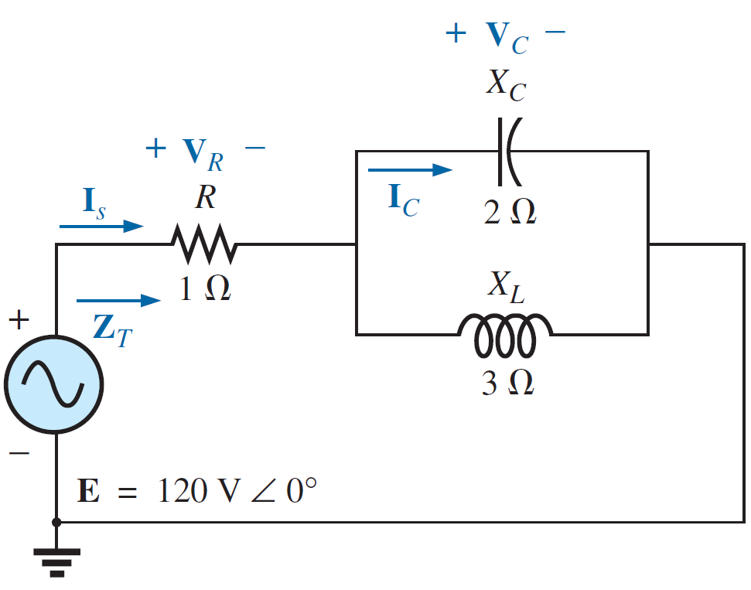
Series-Parallel AC Circuit
EXAMPLE 1: For the circuit in Figure shown below.
a. Calculate Z_{T}.
b. Determine I_{S}.
c. Calculate V_{R} and V_{C}.
d. Find I_{C}.
e. Compute the power delivered.
f. Find F_{p} of the network.

Slide 3
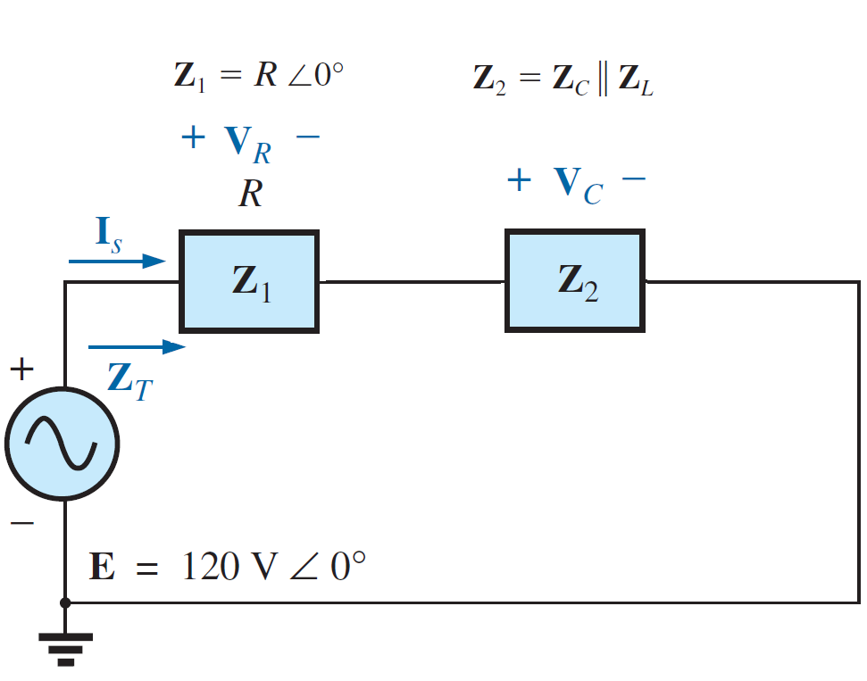
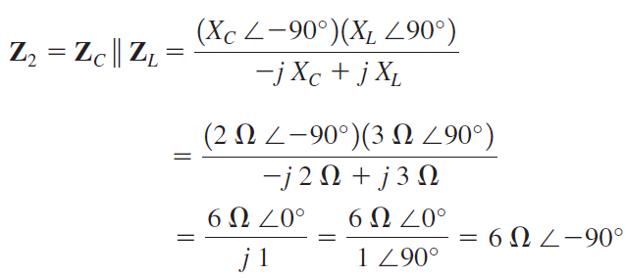
Series-Parallel AC Circuit
EXAMPLE 1: For the circuit in Figure shown below.
Solutions:
a. Calculate Z_{T}.

Slide 4
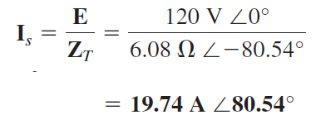
Series-Parallel AC Circuit
EXAMPLE 1: For the circuit in Figure shown below.
Solutions:
b. Determine I_{S}.

Slide 5
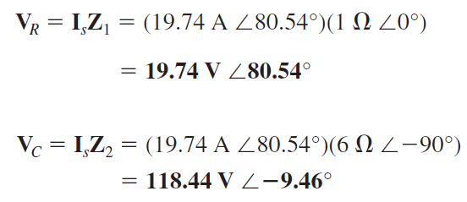
Series-Parallel AC Circuit
EXAMPLE 1: For the circuit in Figure shown below.
Solutions:
c. Calculate V_{R} and V_{C}.

Slide 6
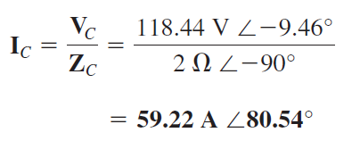
Series-Parallel AC Circuit
EXAMPLE 1: For the circuit in Figure shown below.
Solutions:
d. Find I_{C}.

Slide 7
Series-Parallel AC Circuit
EXAMPLE 1: For the circuit in Figure shown below.
Solutions:
e. Compute the power delivered.

Slide 8
Series-Parallel AC Circuit
EXAMPLE 1: For the circuit in Figure shown below.
Solutions:
f. Find F_{p} of the network.

Slide 9
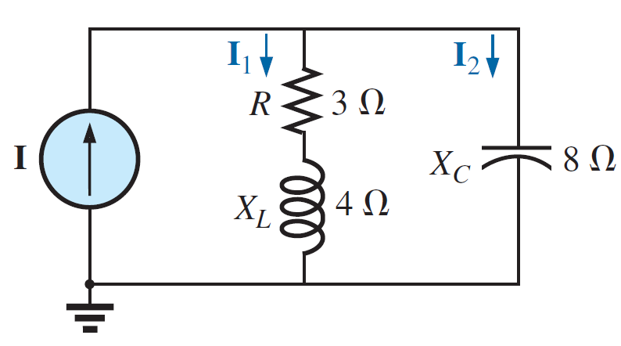
Series-Parallel AC Circuit
EXAMPLE 2: For the circuit in Figure shown below.
a. If I is $50A∠{30}^{o}$, calculate I₁ using the current divider rule.
b. Repeat part (a) for I₂.
c. Verify Kirchhoff’s current law at one node.
$$50A∠{30}^{o}$$

Slide 10
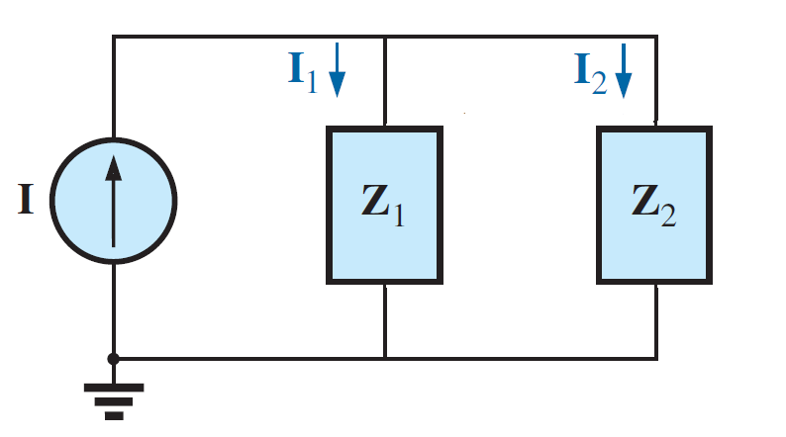
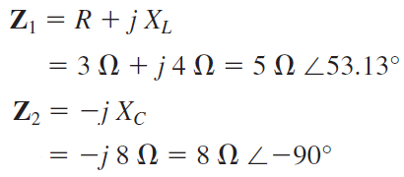
Series-Parallel AC Circuit
EXAMPLE 2: For the circuit in Figure shown below.
a. If I is $50A∠{30}^{o}$, calculate I₁ using the current divider rule.
Solutions:
$$50A∠{30}^{o}$$

Slide 11
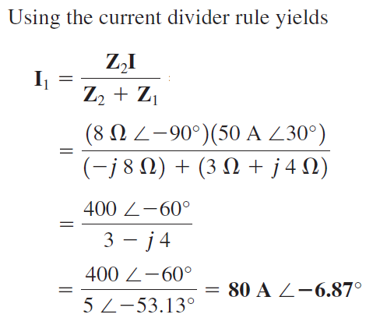
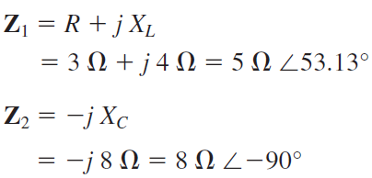
Series-Parallel AC Circuit
EXAMPLE 2: For the circuit in Figure shown below.
a. If I is $50A∠{30}^{o}$, calculate I₁ using the current divider rule.
Solutions:
$$50A∠{30}^{o}$$

Slide 12
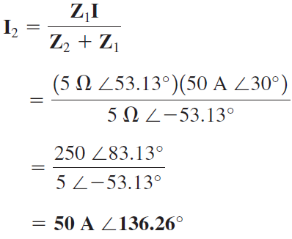
Series-Parallel AC Circuit
EXAMPLE 2: For the circuit in Figure shown below.
b. Repeat part (a) for I₂.
Solutions:
$$50A∠{30}^{o}$$

Slide 13
Series-Parallel AC Circuit
EXAMPLE 2: For the circuit in Figure shown below.
c. Verify Kirchhoff’s current law at one node.
Solutions:
$$50A∠{30}^{o}$$

Slide 14
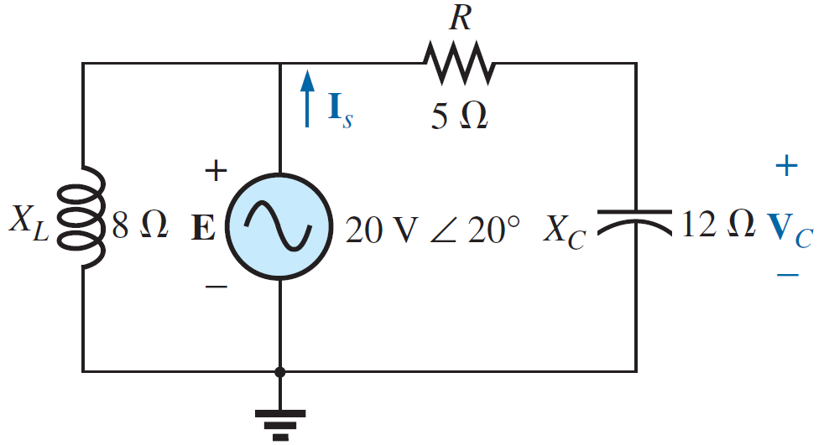
Series-Parallel AC Circuit
EXAMPLE 3: For the circuit in Figure shown below.
a. Calculate V_{C} using the voltage divider rule.
b. Determine I_{S}.

Slide 15
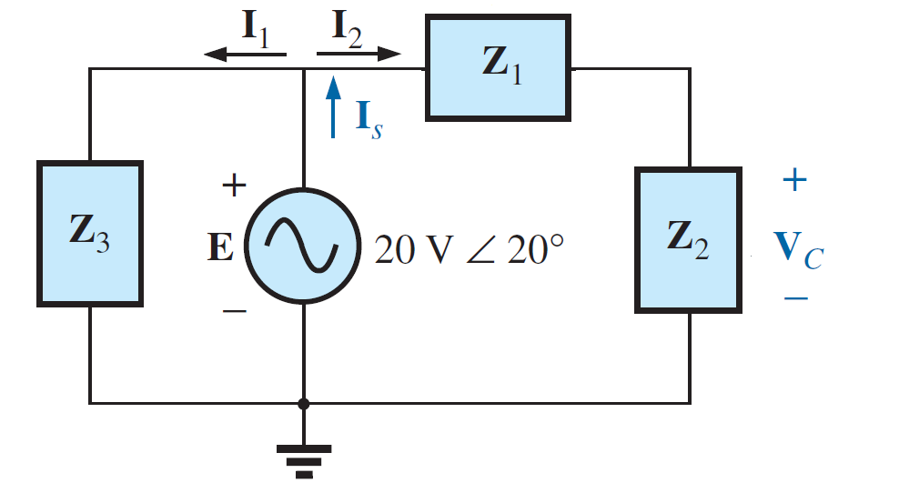
Series-Parallel AC Circuit
EXAMPLE 3: For the circuit in Figure shown below.
a. Calculate V_{C} using the voltage divider rule.
Solutions:

Slide 16
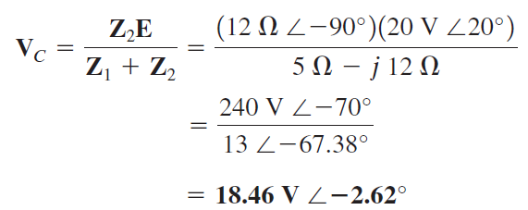
Series-Parallel AC Circuit
EXAMPLE 3: For the circuit in Figure shown below.
a. Calculate V_{C} using the voltage divider rule.
Solutions:

Slide 17
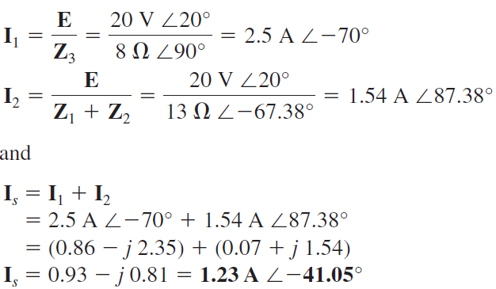
Series-Parallel AC Circuit
EXAMPLE 3: For the circuit in Figure shown below.
b. Determine I_{S}.
Solutions:

Slide 18
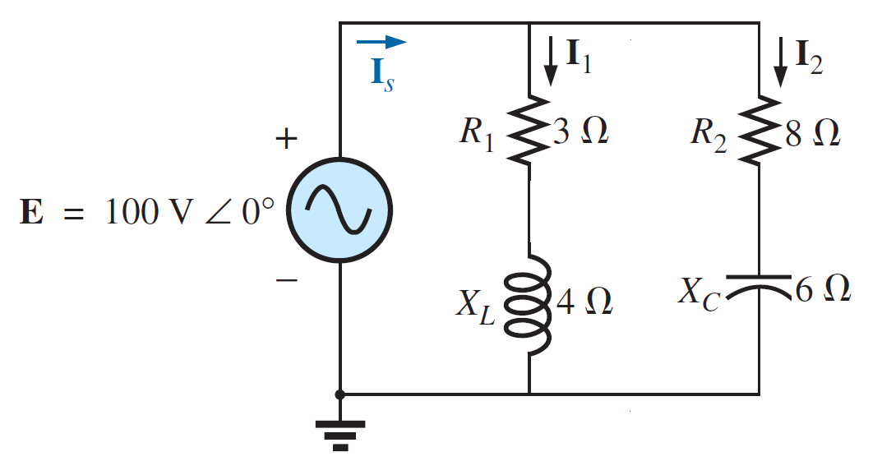
Series-Parallel AC Circuit
EXAMPLE 4: For the circuit in Figure shown below.
a. Calculate Z_{T}.
b. Determine I_{S} , I₁, and I₂.

Slide 19
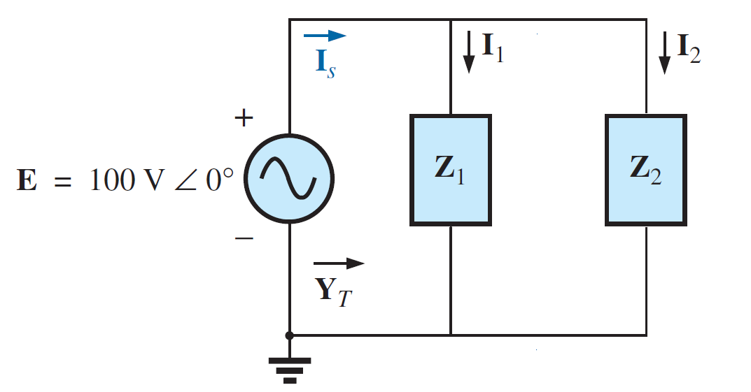
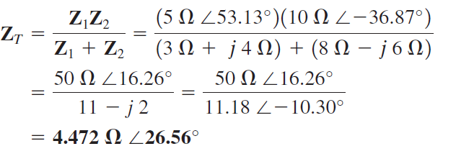
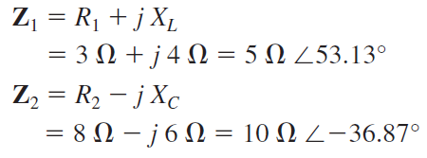
Series-Parallel AC Circuit
EXAMPLE 4: For the circuit in Figure shown below.
a. Calculate Z_{T}.
Solutions:

Slide 20
Series-Parallel AC Circuit
EXAMPLE 4: For the circuit in Figure shown below.
b. Determine I_{S} , I₁, and I₂.
Solutions:

Slide 21
Series-Parallel AC Circuit
EXAMPLE 4: For the circuit in Figure shown below.
b. Determine I_{S} , I₁, and I₂.
Solutions:

Slide 22
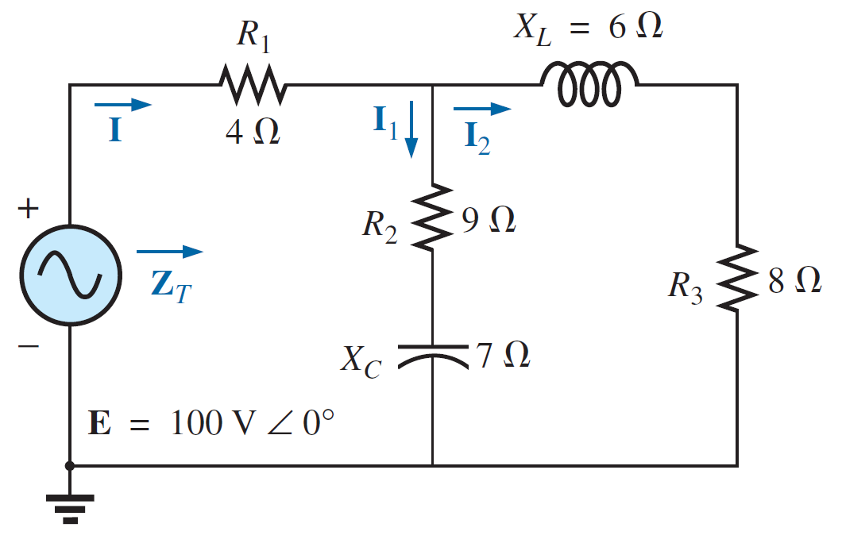
Series - Parallel RLC example problems

Slide 23
Series-Parallel AC Circuit
EXAMPLE 5: For the circuit in Figure shown below.
a. Calculate the total impedance Z_{T}.
b. Compute I.
c. Calculate I₁ and I₂ .
d. Find the average power delivered to the circuit.
e. Find the total power factor.

Slide 24
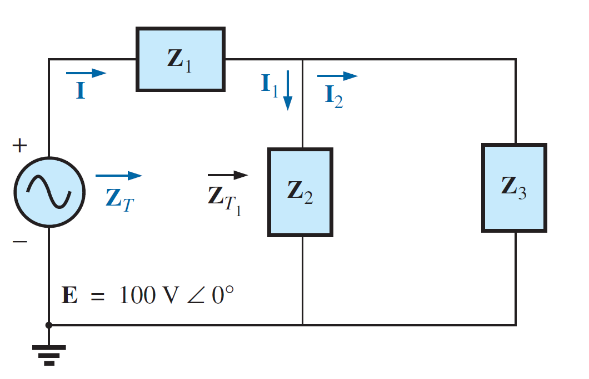
Series-Parallel AC Circuit
EXAMPLE 5: For the circuit in Figure shown below.
a. Calculate the total impedance Z_{T}.
Solutions:

Slide 25
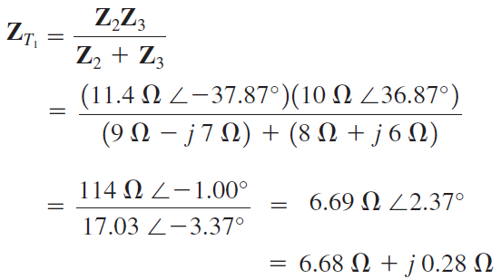
Series-Parallel AC Circuit
EXAMPLE 5: For the circuit in Figure shown below.
a. Calculate the total impedance Z_{T}.
Solutions:

Slide 26
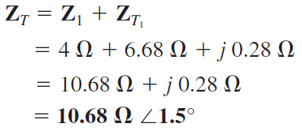
Series-Parallel AC Circuit
EXAMPLE 5: For the circuit in Figure shown below.
a. Calculate the total impedance Z_{T}.
Solutions:

Slide 27
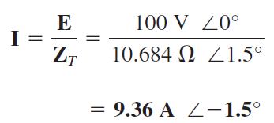
Series-Parallel AC Circuit
EXAMPLE 5: For the circuit in Figure shown below.
b. Compute I.
Solutions:

Slide 28
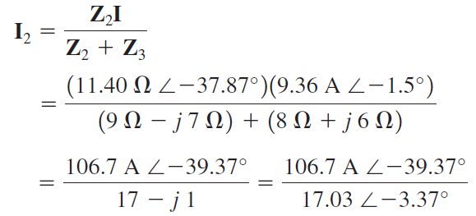
Series-Parallel AC Circuit
EXAMPLE 5: For the circuit in Figure shown below.
c. Calculate I₁ and I₂ .
Solutions:

Slide 29
Series-Parallel AC Circuit
EXAMPLE 5: For the circuit in Figure shown below.
c. Calculate I₁ and I₂ .
Solutions:

Slide 30
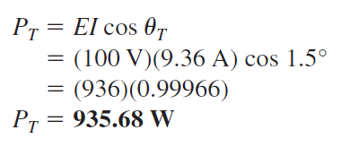
Series-Parallel AC Circuit
EXAMPLE 5: For the circuit in Figure shown below.
d. Find the average power delivered to the circuit.
Solutions:

Slide 31
Series-Parallel AC Circuit
EXAMPLE 5: For the circuit in Figure shown below.
e. Find the total power factor.
Solutions:

Slide 32
References
Boylestad, Robert L. Introductory circuit analysis. Pearson Education, 2010.
Robbins, Allan H., and Wilhelm C. Miller. Circuit analysis: Theory and practice. Cengage Learning, 2012.
Sadiku, Matthew NO, and Chales K. Alexander. Fundamentals of electric circuits. McGraw-Hill Higher Education, 2007.

